Slide 1

Artificial Neural Network: Backpropagation
Mina Farmanbar
Associate Professor, University of Stavanger
for engineers

Slide 2



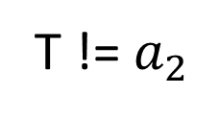






Backpropagation
$$x_{1}=0.1$$
$$a_{1}=f(z)$$
$$z_{2}$$
$=a_{1}$.$w_{2}$ + ${ b}_{2}$
$$a_{2}=f(z)$$
$$z_{1}$$
$=x_{1}$.$w_{1}$ + ${ b}_{1}$
$w_{1}$ = 0.15
$w_{2}$ = 0.45
$b_{1}$ = 0.40
$b_{2}$ = 0.65
T: Ground Truth
T != $a_{2}$

Slide 3
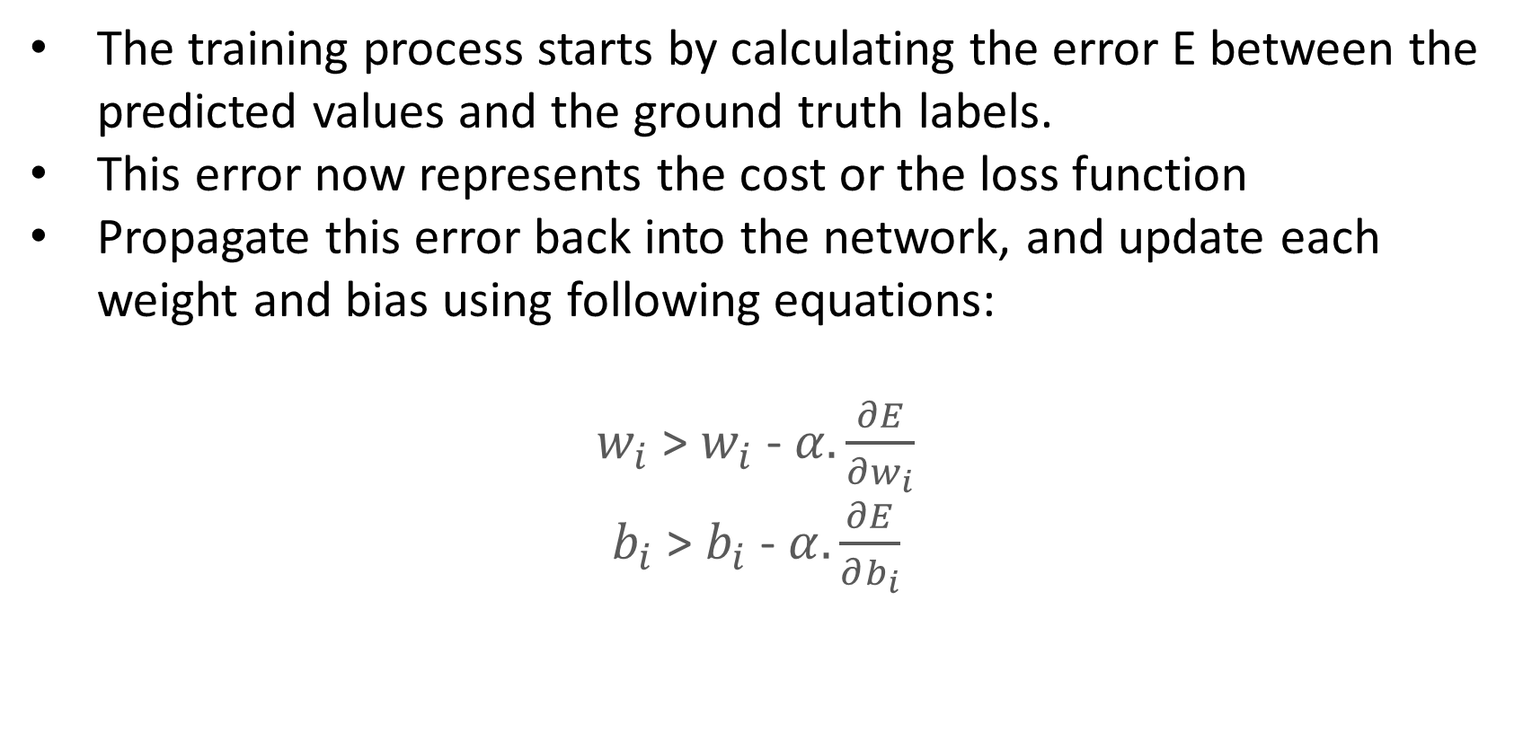
Backpropagation
The training process starts by calculating the error E between the predicted values and the ground truth labels.
This error now represents the cost or the loss function
Propagate this error back into the network, and update each weight and bias using following equations:
$w_{i}$ > $w_{i}$ - $α.\frac{∂E}{∂w_{i}}$
$b_{i}$ > $b_{i}$ - $α.\frac{∂E}{∂b_{i}}$

Slide 4



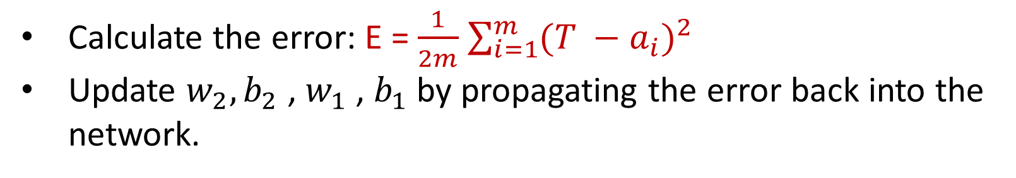






Backpropagation
T: Ground Truth
$$x_{1}=0.1$$
$$a_{1}=f(z)$$
$$z_{2}$$
$=a_{1}$.$w_{2}$ + ${ b}_{2}$
$$a_{2}=f(z)$$
$$z_{1}$$
$=x_{1}$.$w_{1}$ + ${ b}_{1}$
$w_{1}$ = 0.15
$w_{2}$ = 0.45
E
$b_{1}$ = 0.40
$b_{2}$ = 0.65
Calculate the error: E = $\frac{1}{2m}$ $\sum_{i=1}^{m}{{(T −a_{i})}^{2}}$
Update $w_{2}, b_{2}$ , $w_{1}$ , $b_{1}$ by propagating the error back into the network.

Slide 5

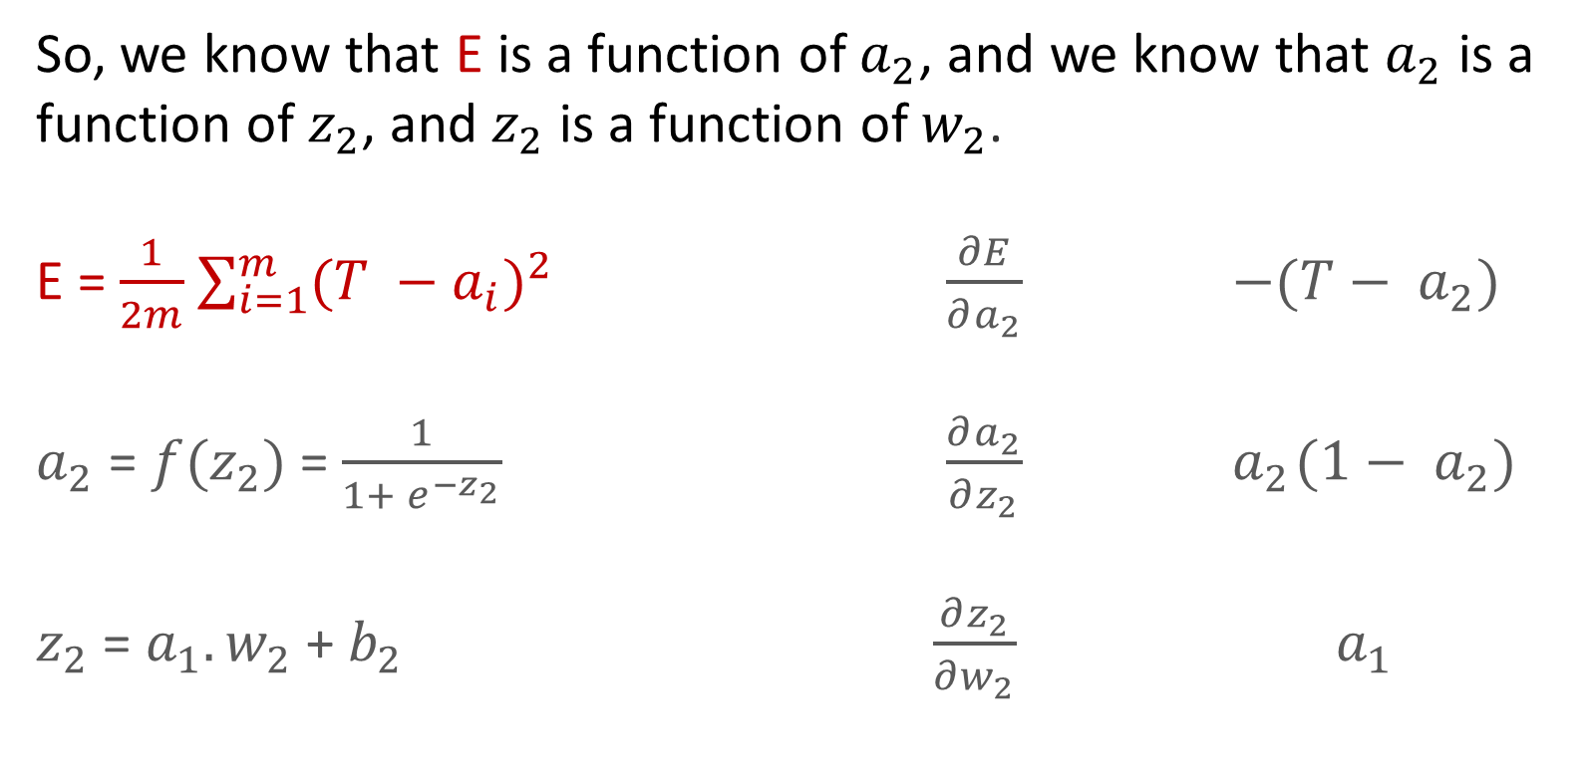
Updating $w_{2}$
So, we know that E is a function of $a_{2}$, and we know that $a_{2}$ is a function of${ z}_{2}$, and $z_{2}$ is a function of $w_{2}$.
E = $\frac{1}{2m}$ $\sum_{i=1}^{m}{{(T −a_{i})}^{2}}$ $\frac{∂E}{∂a_{2}}$ $−(T− a_{2})$
$a_{2}$ = $f(z_{2})$= $\frac{1}{1+ e^{−z_{2}}}$ $\frac{∂a_{2}}{∂z_{2}}{ a}_{2}(1− a_{2})$
$z_{2}$ = $a_{1}.w_{2}$ + $b_{2}$ $\frac{∂z_{2}}{∂w_{2}}$ ${ a}_{1}$

Slide 6
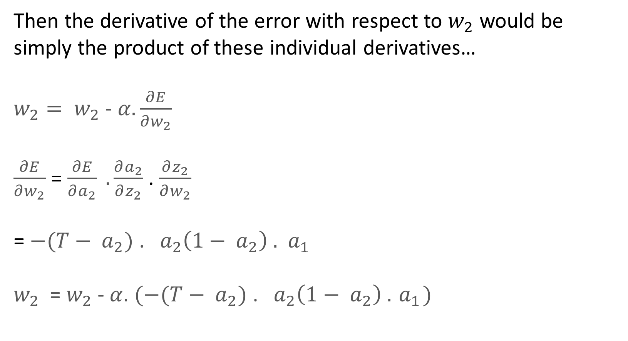
Backpropagation
Then the derivative of the error with respect to $w_{2}$ would be
simply the product of these individual derivatives…
${w_{2}= w}_{2}$ - $α.\frac{∂E}{∂w_{2}}$
$\frac{∂E}{∂w_{2}}$ = $\frac{∂E}{∂a_{2}} .\frac{∂a_{2}}{∂z_{2}}$ . $\frac{∂z_{2}}{∂w_{2}}$
= $−(T− a_{2})$ . ${ a}_{2}\left(1− a_{2}\right) .{ a}_{1}$
$w_{2}$ = $w_{2}$- $α.$ $(−(T− a_{2})$ . ${ a}_{2}\left(1− a_{2}\right) .{ a}_{1})$

Slide 7


Updating $b_{2}$
${b_{2}=b}_{2}$ - $α.\frac{∂E}{∂b_{2}}$
$\frac{∂E}{∂b_{2}}$ = $\frac{∂E}{∂a_{2}} .\frac{∂a_{2}}{∂z_{2}}$ . $\frac{∂z_{2}}{∂b_{2}}$
= $−(T− a_{2})$) . ${ (a}_{2}\left(1− a_{2}\right) . 1$
$b_{2}$ = $b_{2}$- $α.$ $(−(T− a_{2})$ . ${ a}_{2}\left(1− a_{2}\right) . 1)$

Slide 8

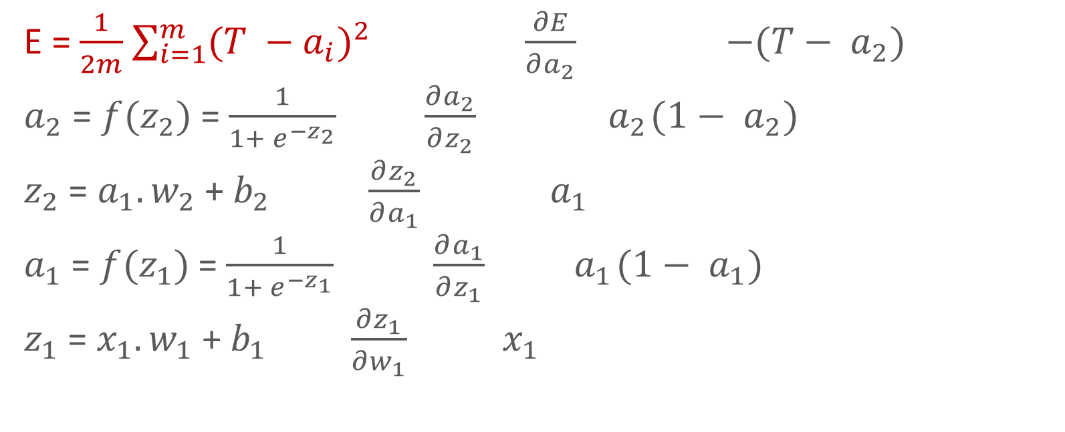
Updating $w_{1}$
E = $\frac{1}{2m}$ $\sum_{i=1}^{m}{{(T −a_{i})}^{2}}$ $\frac{∂E}{∂a_{2}}$ $−(T− a_{2})$
$a_{2}$ = $f(z_{2})$= $\frac{1}{1+ e^{−z_{2}}}$ $\frac{∂a_{2}}{∂z_{2}}{ a}_{2}(1− a_{2})$
$z_{2}$ = $a_{1}.w_{2}$ + $b_{2}$ $\frac{∂z_{2}}{∂a_{1}}$ ${ a}_{1}$
$a_{1}$ = $f(z_{1})$= $\frac{1}{1+ e^{−z_{1}}}$ $\frac{∂a_{1}}{∂z_{1}}{ a}_{1}(1− a_{1})$
$z_{1}$ = $x_{1}.w_{1}$ + $b_{1}$ $\frac{∂z_{1}}{∂w_{1}}$ ${ x}_{1}$

Slide 9
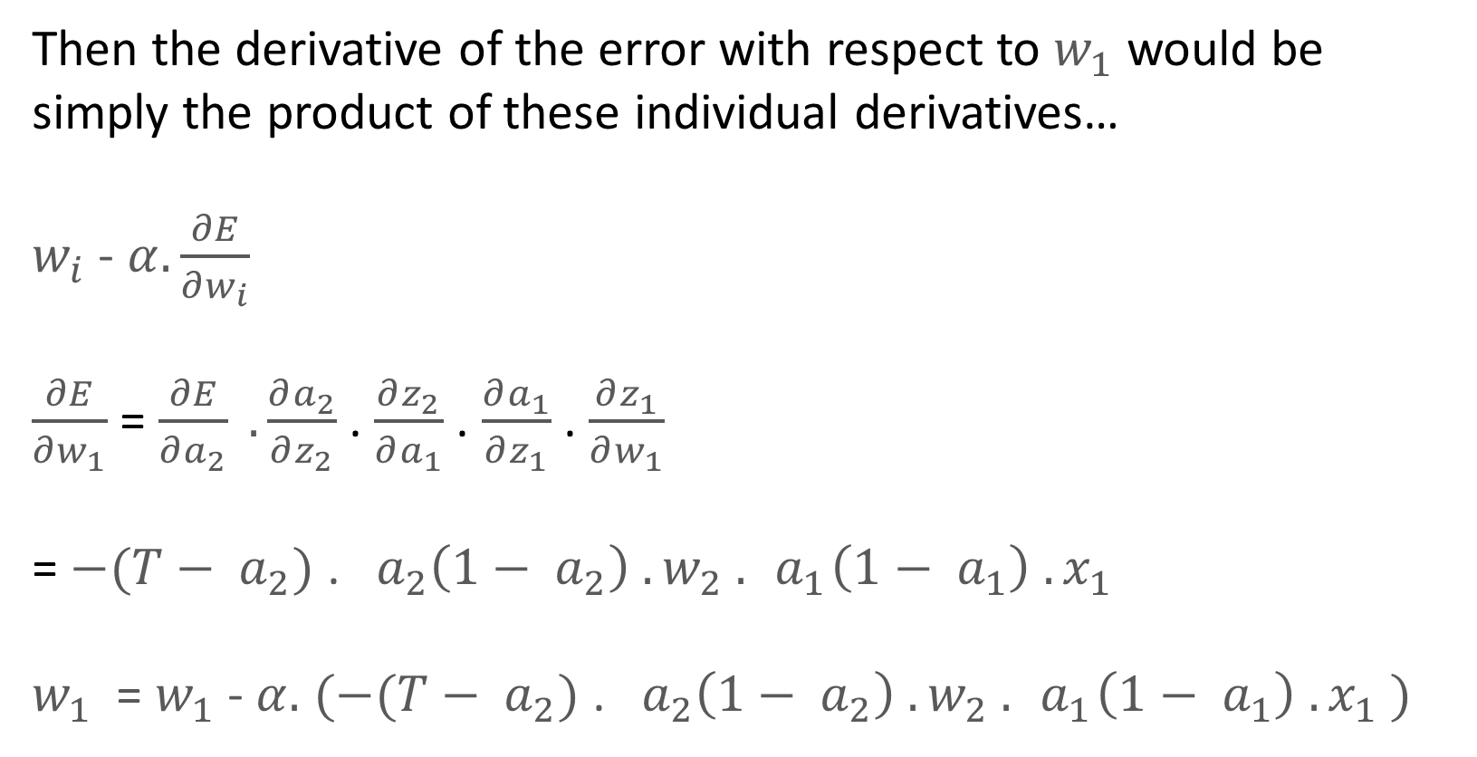
Backpropagation
Then the derivative of the error with respect to $w_{1}$ would be
simply the product of these individual derivatives…
$w_{i}$ - $α.\frac{∂E}{∂w_{i}}$
$\frac{∂E}{∂w_{1}}$ = $\frac{∂E}{∂a_{2}} .\frac{∂a_{2}}{∂z_{2}}$ . $\frac{∂z_{2}}{∂a_{1}}$ . $\frac{∂a_{1}}{∂z_{1}}$ . $\frac{∂z_{1}}{∂w_{1}}$
= $−(T− a_{2})$ . ${ a}_{2}\left(1− a_{2}\right) . w_{2} . { a}_{1}\left(1− a_{1}\right) . x_{1}$
$w_{1}$ = $w_{1}$- $α.$ $(−(T− a_{2})$ . ${ a}_{2}\left(1− a_{2}\right) . w_{2} . { a}_{1}\left(1− a_{1}\right) . x_{1} )$

Slide 10

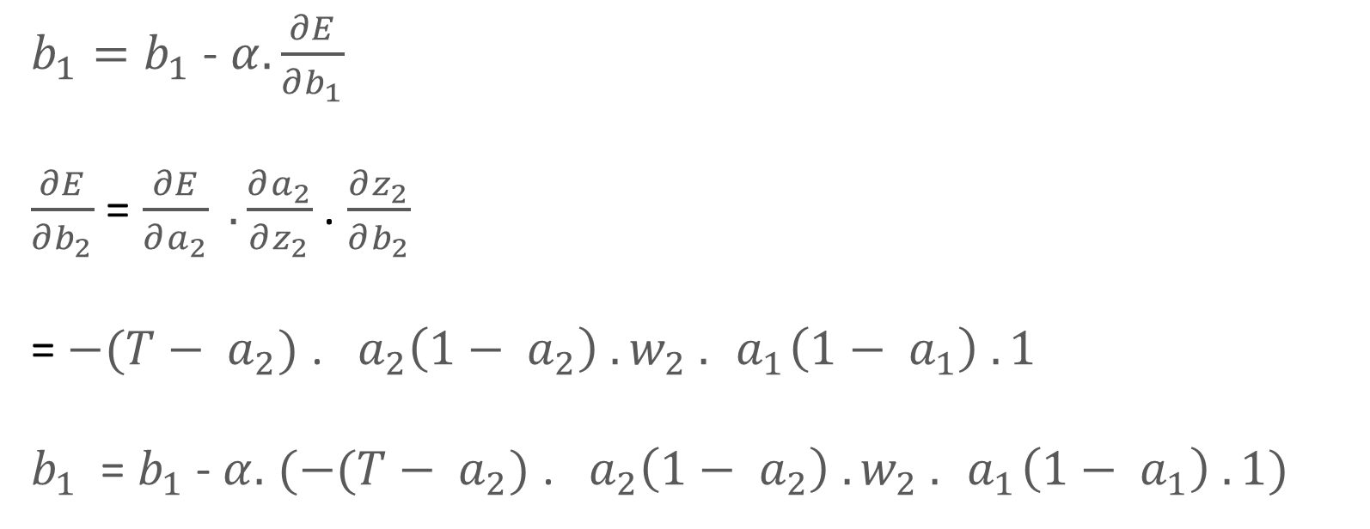
Updating $b_{1}$
${b_{1}=b}_{1}$ - $α.\frac{∂E}{∂b_{1}}$
$\frac{∂E}{∂b_{2}}$ = $\frac{∂E}{∂a_{2}} .\frac{∂a_{2}}{∂z_{2}}$ . $\frac{∂z_{2}}{∂b_{2}}$
= $−(T− a_{2})$ . ${ a}_{2}\left(1− a_{2}\right) . w_{2} . { a}_{1}\left(1− a_{1}\right) . 1$
$b_{1}$ = $b_{1}$- $α.$ $(−(T− a_{2})$ . ${ a}_{2}\left(1− a_{2}\right) . w_{2} . { a}_{1}\left(1− a_{1}\right) . 1)$

Slide 11










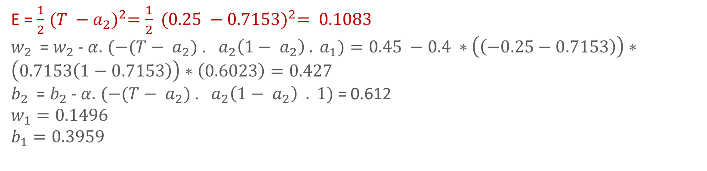
Forward propagation
T: Ground Truth = 0.25
Epochs = 1000
$α$ = 0.4
$$ε=0.001$$
$$x_{1}=0.1$$
$$a_{1}=f(z)$$
$$z_{2}$$
$=a_{1}$.$w_{2}$ + ${ b}_{2}$
$$a_{2}=f(z)$$
$$z_{1}$$
$=x_{1}$.$w_{1}$ + ${ b}_{1}$
$w_{1}$ = 0.15
$w_{2}$ = 0.45
$b_{1}$ = 0.40
$b_{2}$ = 0.65
$z_{1}=0.415$,$a_{1}= 0.6023, z_{2}=0.9210, a_{2}=0.7153$
E = $\frac{1}{2}$ ${(T −a_{2})}^{2}=\frac{1}{2} {(0.25 −0.7153)}^{2}= 0.1083$
$w_{2}$ = $w_{2}$- $α.$ $(−(T− a_{2})$ . ${ a}_{2}\left(1− a_{2}\right) . a_{1})=0.45 −0.4 ∗\left(\left(−0.25−0.7153\right)\right)∗\left(0.7153\left(1−0.7153\right)\right)∗\left(0.6023\right)=0.427$
$b_{2}$ = $b_{2}$- $α.$ $(−(T− a_{2})$ . ${ a}_{2}\left(1− a_{2}\right) . 1)$ = 0.612
$$w_{1}=0.1496$$
$$b_{1}=0.3959$$

Slide 12
Complete Training Algorithm
Initialize the weights and the biases
Iteratively repeat the following steps:
Calculate network output using forward propagation
Calculate error between ground truth and estimated or predicted output
Update weights and biases through backpropagation
Repeat the above three steps until number of iterations/epochs is reached or error between ground truth and predicted output is below a predicted threshold

Slide 13
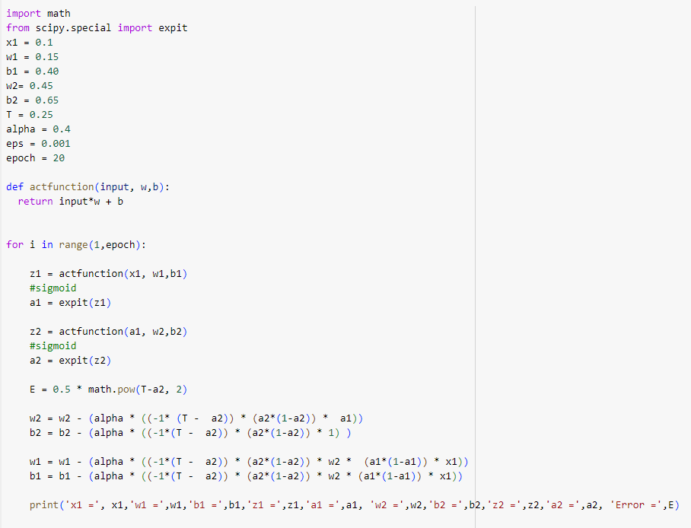
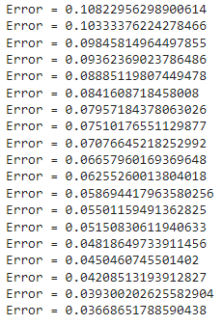
Complete Training Algorithm

Slide 14
Thank you!
Mina Farmanbar
mina.farmanbar@uis.no

